Slide 1
Java Beans Java database connectivity (JDBC) Java Servlets
UNIT-V

Slide 2
JAVA BEANS

Slide 3
What Is a Java Bean?
A Java Bean is a software component that has been designed to be reusable in a variety of
different environments.
It may perform a simple function, such as obtaining a simple sum-average value, or a complex function, such as forecasting the performance of a stock portfolio.
A bean encapsulates many objects into one object, so we can access this object from multiple places

Slide 4
Java Bean
A Java Bean is a java class that should follow following conventions:
It should have a no argument constructor.
It should be Serializable [This allows applications and frameworks to reliably save, store, and restore the bean's state in a manner independent of the VM and of the platform.]
It should provide methods to set and get the values of the properties, known as getter and setter methods.

Slide 5
Properties
A property is a subset of a Bean’s state. The values assigned to the properties determine the behavior and appearance of that component.
A property is set through a setter method.
A property is obtained by a getter method. There are two types of properties: simple and indexed.

Slide 6
Simple Properties
A simple property has a single value. It can be identified by the following design patterns,
where N is the name of the property and T is its type:
public T getN( )
public void setN(T arg)

Slide 7
Simple example of java bean class
//Employee.java
package mypack;
public class Employee implements java.io.Serializable{
private int id;
private String name;
public Employee(){}
public void setId(int id){this.id=id;}
public int getId(){return id;}
public void setName(String name){this.name=name;}
public String getName(){return name;}
}

Slide 8
to access the java bean class
package mypack;
public class Test{
public static void main(String args[])
{
Employee e=new Employee(); //object is created
e.setName("Arjun"); //setting value to the object
System.out.println(e.getName());
}
}

Slide 9
JDBC

Slide 10
What is JDBC?
Java programs communicate with databases and manipulate their data using the Java Database Connectivity (JDBC) API.
For doing this, a JDBC driver is required. It enables Java applications to connect to a database in a particular DBMS and allows user to manipulate that database using the JDBC API.

Slide 11
JDBC Drivers Types
JDBC driver implementations vary because of the wide variety of operating systems and hardware platforms in which Java operates. Sun has divided the implementation types into four categories, Types 1, 2, 3, and 4.
Type 1: JDBC-ODBC Bridge Driver
Type 2: JDBC-Native API
Type 3: JDBC-Network-Protocol driver
Type 4: Database-Protocol driver (Pure Java)

Slide 12
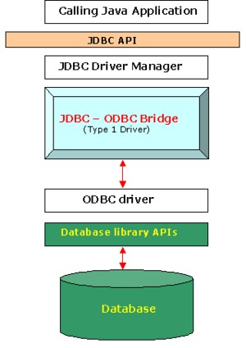
Type 1: JDBC-ODBC Bridge Driver
The JDBC type 1 driver, also known as the JDBC-ODBC bridge, is a database driver implementation that employs the ODBC driver to connect to the database. The driver converts JDBC function calls into ODBC function calls.
The driver is platform-dependent as it makes use of ODBC which in turn depends on native libraries of the underlying operating system the JVM is running upon.

Slide 13
Type 1: JDBC-ODBC Bridge Driver
Advantages
Almost any database for which an ODBC driver is installed can be accessed, and data can be retrieved.
Disadvantages
Performance overhead since the calls have to go through the JDBC bridge to the ODBC driver, then to the native db connectivity interface (thus may be slower than other types of drivers).
The ODBC driver needs to be installed on the client machine.
Not suitable for applets, because the ODBC driver needs to be installed on the client.

Slide 14
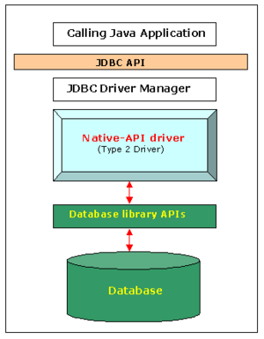
Type 2: JDBC-Native API
The JDBC type 2 driver, also known as the Native-API driver, is a database driver implementation that uses the client-side libraries of the database. The driver converts JDBC method calls into native calls of the database API. For example: Oracle OCI driver is a type 2 driver.

Slide 15
Type 2: JDBC-Native API
Advantages
As there is no implementation of JDBC-ODBC bridge, its considerably faster than a type 1 driver.
Disadvantages
The vendor client library needs to be installed on the client machine.
Not all databases have a client side library.
This driver is platform dependent.
This driver supports all java applications except applets.

Slide 16
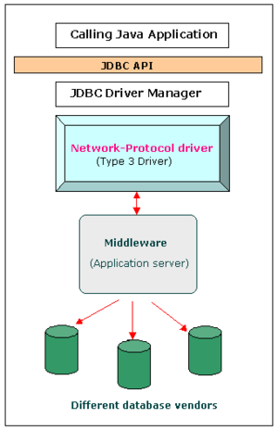
Type 3 driver – Network-Protocol driver
The JDBC type 3 driver, also known as the Middleware Java driver, is a database driver implementation which makes use of a middle tier between the calling program and the database.
The middle-tier (application server) converts JDBC calls directly or indirectly into the vendor-specific database protocol.

Slide 17
Type 3 driver – Network-Protocol driver
Sends JDBC API calls to a middle-tier net server that translates the calls into the DBMS-specific network protocol. The translated calls are then sent to a particular DBMS.
Follows a three tier communication approach.
Can interface to multiple databases – Not vendor specific.
The JDBC Client driver written in java, communicates with a middleware-net-server using a database independent protocol, and then this net server translates this request into database commands for that database.
Thus the client driver to middleware communication is database independent.

Slide 18
Type 4 driver – Database-Protocol driver
The JDBC type 4 driver, also known as the Direct to Database Pure Java Driver, is a database driver implementation that converts JDBC calls directly into a vendor-specific database protocol.
Written completely in Java, type 4 drivers are thus platform independent.
They install inside the Java Virtual Machine of the client. This provides better performance than the type 1 and type 2 drivers as it does not have the overhead of conversion of calls into ODBC or database API calls.
Unlike the type 3 drivers, it does not need associated software to work.

Slide 19
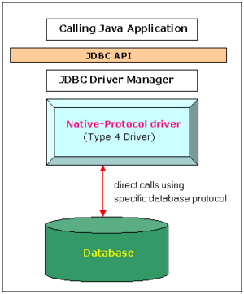
Type 4 driver – Database-Protocol driver
Advantages
Completely implemented in Java to achieve platform independence.
These drivers don't translate the requests into an intermediary format (such as ODBC).
The client application connects directly to the database server. No translation or middleware layers are used, improving performance.
Disadvantages
Drivers are database dependent, as different database vendors use widely different (and usually proprietary) network protocols

Slide 20
Which Driver should be Used?
If you are accessing one type of database, such as Oracle, Sybase, or IBM, the preferred driver type is 4.
If your Java application is accessing multiple types of databases at the same time, type 3 is the preferred driver.
Type 2 drivers are useful in situations, where a type 3 or type 4 driver is not available yet for your database.
The type 1 driver is not considered a deployment-level driver, and is typically used for development and testing purposes only.

Slide 21
Steps to connect to the database in java
There are 6 steps to connect any java application with the database in java using JDBC. They are as follows:
Import JDBC Packages (import java.sql.* ; // for standard JDBC programs)
Register the driver class
Creating connection
Creating statement
Executing queries
Closing connection

Slide 22
2. Register the driver class:
The most common approach to register a driver is to use Java's Class.forName() method, to dynamically load the driver's class file into memory, which automatically registers it. This method is preferable because it allows you to make the driver registration configurable and portable.
Example to register the OracleDriver and mysql class:
Class.forName("oracle.jdbc.driver.OracleDriver");
Class.forName("com.mysql.jdbc.Driver");

Slide 23
3. Create the Connection object:
After loading the driver, we can establish a connection using the DriverManager.getConnection() method.
Three overloaded DriverManager.getConnection() methods −
getConnection(String url)
getConnection(String url, Properties prop)
getConnection(String url, String user, String password)

Slide 24
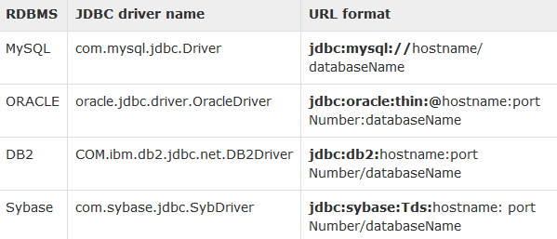
A database URL is an address that points to your database.
Following table lists down the popular JDBC driver names and database URL.
Example to establish connection with the Oracle database
Connection con=DriverManager.getConnection(
"jdbc:oracle:thin:@localhost:1521:xe","system","password");

Slide 25
4. Create the Statement object:
The createStatement() method of Connection interface is used to create statement. The object of statement is responsible to execute queries with the database.
Statement stmt = null;
Stmt = con.createStatement();

Slide 26
5. Execute the query:
The executeQuery() method of Statement interface is used to execute queries to the database. This method returns the object of ResultSet that can be used to get all the records of a table.
ResultSet rs=stmt.executeQuery("select * from tbl_st");
while(rs.next()) {
System.out.println(rs.getInt(1)+" "+rs.getString(2));
}

Slide 27
Other methods
boolean execute(String SQL) : Returns a boolean value of true if a ResultSet object can be retrieved; otherwise, it returns false. Use this method to execute SQL DDL statements or when you need to use the truly dynamic SQL.
int executeUpdate(String SQL): Returns the number of rows affected by the execution of the SQL statement. Use this method to execute SQL statements, for which you expect to get a number of rows affected - for example, an INSERT, UPDATE, or DELETE statement.
ResultSet executeQuery(String SQL): Returns a ResultSet object. Use this method when you expect to get a result set, as you would with a SELECT statement.

Slide 28
6. Close the connection object:
By closing connection object statement and ResultSet will be closed automatically. The close() method of Connection interface is used to close the connection.
con.close();

Slide 29
Example to Connect Java Application with mysql database

Slide 30
import java.sql.*;
class MysqlCon {
public static void main(String args[]) {
try {
Class.forName("com.mysql.jdbc.Driver");
Connection con=DriverManager.getConnection (
"jdbc:mysql://localhost:3306/TestData","root",“pwd“ );
//here TestData is database name, root is username and pwd is password
Statement stmt=con.createStatement();
ResultSet rs=stmt.executeQuery("select * from tbl_st");
while(rs.next())
System.out.println (“ID =“ +rs.getInt(“id”)+ "+ Name = “ +rs.getString(“Name”) );
con.close();
} catch(Exception e){ System.out.println(e);}
}
}

Slide 31
// INSERT a record
String sqlInsert = "insert into tbl_st values (3001, ‘Kumar')";
System.out.println("The SQL query is: " + sqlInsert);
int countInserted = stmt.executeUpdate(sqlInsert); System.out.println(countInserted + " records inserted.\n");
// DELETE records with id>=30 and id<40
String sqlDelete = "delete from tbl_st where id>=3000 and id<4000";
int countDeleted = stmt.executeUpdate(sqlDelete); System.out.println(countDeleted + " records deleted.\n");

Slide 32
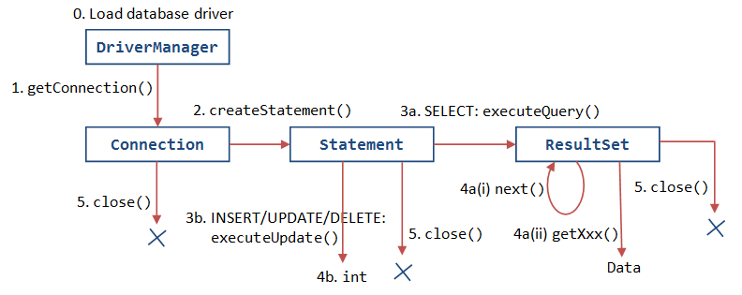
JDBC cycle

Slide 33
Statement interface
The Statement interface provides methods to execute queries with the database. The statement interface is a factory of ResultSet i.e. it provides factory method to get the object of ResultSet.
The important methods of Statement interface are as follows:
1) public ResultSet executeQuery(String sql): is used to execute SELECT query. It returns the object of ResultSet.
2) public int executeUpdate(String sql): is used to execute specified query, it may be create, drop, insert, update, delete etc.
3) public boolean execute(String sql): is used to execute queries that may return multiple results.
4) public int[] executeBatch(): is used to execute batch of commands.

Slide 34
Servlets

Slide 35
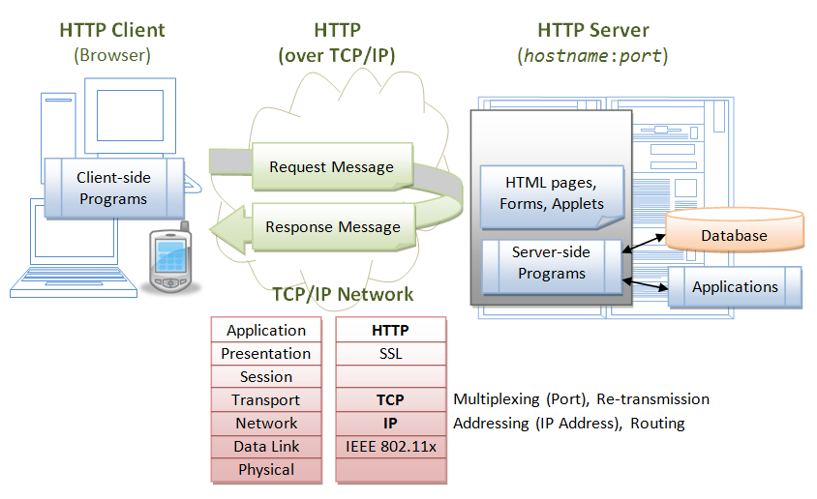
Web application

Slide 36
What is Servlet?
Servlet is used to create web application (resides at server side and generates dynamic web page). Servlet programs execute on the server side.
The javax.servlet and javax.servlet.http packages provide interfaces and classes for writing our own servlets.

Slide 37
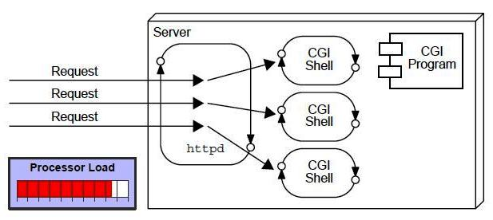
Background
Common Gateway Interface (CGI) suffered serious performance problems. It was expensive in terms of processor and memory resources to create a separate process for each client request for Dynamic content web pages.
It was also expensive to open and close database connections for each client request. CGI programs were not platform-independent

Slide 38
Advantages
Servlets provide better performance that CGI in terms of processing time, memory utilization because servlets uses benefits of multithreading and for each request a new thread is created, that is faster than loading creating new Object for each request with CGI.
Servlets and platform and system independent, the web application developed with Servlet can be run on any standard web container such as Tomcat, JBoss, Glassfish servers and on operating systems such as Windows, Linux, Unix, Solaris, Mac etc.
Servlets are robust because container takes care of life cycle of servlet and we don’t need to worry about memory leaks, security, garbage collection etc.

Slide 39
Servlet Container
Servlet containers are also known as web container, for example Tomcat. Some of the important tasks of servlet container are:
Communication Support: Servlet Container provides easy way of communication between web client (Browsers) and the servlets and JSPs. Because of container, we don’t need to build a server socket to listen for any request from web client, parse the request and generate response. All these important and complex tasks are done by container and all we need to focus is on business logic for the applications.
Lifecycle and Resource Management: Servlet Container takes care of managing the life cycle of servlet. From the loading of servlets into memory, initializing servlets, invoking servlet methods and to destroy them.
Multithreading Support: Container creates new thread for every request to the servlet and provide them request and response objects to process.

Slide 40
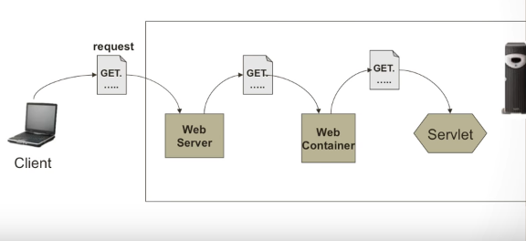
Web container
e.g., Tomcat, GlassFish etc.

Slide 41
ServletConfig object
javax.servlet.ServletConfig is used to pass configuration information to Servlet.
Every servlet has it’s own ServletConfig object and servlet container is responsible for instantiating this object. We can provide servlet init parameters in web.xml file or through use of WebInitParam annotation.

Slide 42
ServletContext object
javax.servlet.ServletContext interface provides access to web application parameters to the servlet.
The ServletContext is unique object and available to all the servlets in the web application.
When we want some init parameters to be available to multiple or all of the servlets in the web application.

Slide 43
Deployment Descriptor
As the name indicates, the deployment descriptor describes the deployment information (or Web Information) of a Servlet. The deployment descriptor is an XML file known as web.xml. XML is the easiest way to give the information to a server, just writing in between the tags, instead of writing in a text file.
Mapping alias name with the actual Servlet name:
First and foremost is the alias name to the Servlet. Never a client is given the actual name of the Servlet. Always an alias name is given just for security.
So primary Job is : It used to map and configure, the servlet classes to the URL.

Slide 44
Example:of Registration form in servlet
Consider register.html
<form action="Register" method="post">
Name:<input type="text" name="userName"/><br/><br/>
Password:<input type="password" name="userPass"/><br/><br/>
Email Id:<input type="text" name="userEmail"/><br/><br/>
<br/><br/>
<input type="submit" value="register"/>
</form>

Slide 45
Now the Web.xml file
<web-app>
<servlet>
<servlet-name>Register</servlet-name>
<servlet-class>Register</servlet-class>
</servlet>
<servlet-mapping>
<servlet-name>Register</servlet-name>
<url-pattern>/servlet/Register</url-pattern>
</servlet-mapping>
<welcome-file-list>
<welcome-file>register.html</welcome-file>
</welcome-file-list>
</web-app>
we need to create the Register.java file i.e., the Servlet

Slide 46
public class Register extends HttpServlet {
public void doPost(HttpServletRequest request, HttpServletResponse response)
throws ServletException, IOException {
response.setContentType("text/html");
PrintWriter out = response.getWriter();
String n=request.getParameter("userName");
String p=request.getParameter("userPass");
String e=request.getParameter("userEmail");
try{
Class.forName("oracle.jdbc.driver.OracleDriver");
Connection con=DriverManager.getConnection(
"jdbc:oracle:thin:@localhost:1521:xe","system","oracle");
PreparedStatement ps=con.prepareStatement( "insert into registeruser values(?,?,?)");
ps.setString(1,n);
ps.setString(2,p);
ps.setString(3,e);
int i=ps.executeUpdate();
if(i>0)
out.print("You are successfully registered...");
}catch (Exception e2) {System.out.println(e2);}
out.close();
}

Slide 47
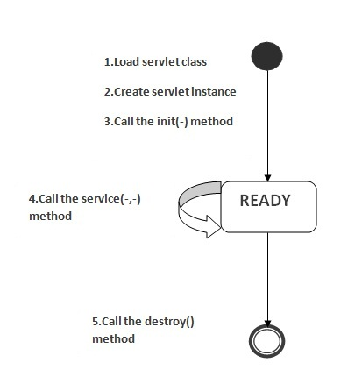
The Life Cycle of a Servlet
Three methods are central to the life cycle of a servlet.
These are
init( )
service( )
destroy( )

Slide 48
public void init(ServletConfig config)
- This method is used by container to initialize the servlet, this method is invoked only once in the lifecycle of servlet.
public void service(ServletRequest request, ServletResponse response) –
This method is called once for every request, container can’t invoke service() method until unless init() method is executed.
public void destroy() –
This method is invoked once when servlet is unloaded from memory.

Slide 49
Scenario to understand the Life Cycle of servlet
First, assume that a user enters a Uniform Resource Locator (URL) to a web browser. The browser then generates an HTTP request for this URL. This request is then sent to the appropriate server.
Second, this HTTP request is received by the web server. The server(web container with web.xml) maps this request to a particular servlet. The servlet is dynamically retrieved and loaded into the address space of the server.
Third, the server invokes the init() method of the servlet. This method is invoked only when the servlet is first loaded into memory. It is possible to pass initialization parameters to the servlet so it may configure itself.

Slide 50
Fourth, the server invokes the service( )method of the servlet. This method is called to process the HTTP request.
The service() method is the main method to perform the actual task. The servlet container calls the service() method to handle requests coming from the client( browsers) and to write the formatted response back to the client.
Each time the server receives a request for a servlet, the server spawns a new thread and calls service. The service() method checks the HTTP request type (GET, POST etc.) and calls doGet, doPost,, etc. methods as appropriate.

Slide 51
Finally, the server may decide to unload the servlet from its memory. The algorithms by which this determination is made are specific to each server.
The server calls the destroy( ) method to relinquish any resources such as file handles that are allocated for the servlet. This method gives your servlet a chance to close database connections, halt background threads and perform other such cleanup activities.

Slide 52
HTTP Request Methods
GET - query string (name/value pairs) is sent in the URL of a GET request:
e.g., GET/test/demo_form.asp?name1=value1&name2=value2
POST - the query string (name/value pairs) is sent in the HTTP message body of a POST request:
e.g., POST /test/demo_form.asp HTTP/1.1 Host: webschools.com name1=value1&name2=value2

Slide 53
doGet() Method
A GET request results from a normal request for a URL or from an HTML form that has no METHOD specified and it should be handled by doGet() method.
public void doGet(HttpServletRequest request, HttpServletResponse response) throws ServletException, IOException
{ // Servlet code }

Slide 54
doPost() Method
A POST request results from an HTML form that specifically lists POST as the METHOD and it should be handled by doPost() method.
public void doPost(HttpServletRequest request, HttpServletResponse response) throws ServletException, IOException
{ // Servlet code }

Slide 55
Handling HTTP get requests
Develop a servlet that handles an HTTP GET request.
The servlet is invoked when a form on a web page is submitted.
The example contains two files.
A web page is defined in ColorGet.htm,
and a servlet is defined in ColorGetServlet.java

Slide 56
ColorGet.html
<html>
<body>
<center>
<form name="Form1"
action="http://localhost:8080/servlets-examples/servlet/ColorGetServlet">
<B>Color:</B>
<select name="color" size="1">
<option value="Red">Red</option>
<option value="Green">Green</option>
<option value="Blue">Blue</option>
</select>
<br><br>
<input type=submit value="Submit">
</form>
</body>
</html>

Slide 57
ColorGetServlet.java
import java.io.*;
import javax.servlet.*;
import javax.servlet.http.*;
public class ColorGetServlet extends HttpServlet
{
public void doGet (HttpServletRequest request,
HttpServletResponse response)
throws ServletException, IOException
{
String color = request.getParameter("color");
response.setContentType("text/html");
PrintWriter pw = response.getWriter();
pw.println("<B>The selected color is: ");
pw.println(color);
pw.close();
}
}

Slide 58
Handling HTTP post requests
<html>
<body>
<center>
<form name="Form1“
Method =“post”
action="http://localhost:8080/servlets-examples/servlet/ColorGetServlet">
<B>Color:</B>
<select name="color" size="1">
<option value="Red">Red</option>
<option value="Green">Green</option>
<option value="Blue">Blue</option>
</select>
<br><br>
<input type=submit value="Submit">
</form>
</body>
</html>

